Slide 1
PROJECT OVERVIEW :
The main goal of this Library Management System is to improve the efficiency and effectiveness of the library.
This helps to reduce the manual work and provides an efficient library service, and also helps in protecting the library from unauthorized access.
This system consists of user login and admin login.
It consists of three modules user, registration and admin. In this firstly, the user have to register in order to use the library for searching the books.

Slide 2
ABSTRACT :
Library Management system is a web based application.
This system acts as tool to transform traditional libraries into digital libraries.
In traditional libraries, the user has to search for books which are hassle process and there is no proper maintenance of database about books and users.
The overall progress of work is slow and it is impossible to generate a fast report.
This system generally aimed in developing a computerized system which is used to maintain everyday work of Library.
This system has features like user login, Admin login, Searching for books, etc.
The main access of the library system will be given to the Admin (administrator) of the library where Admin can access and monitor the daily activities of the library.

Slide 3
PROPOSED METHODOLOGY :
LIBRARY MANAGEMENT SYSTEM
USER
ADMIN
MySQL DATABASE
USER DETAILS
ADD STUDENT /BOOK DETAILS
MySQL DATABASE
BOOK ISSUE
USER REGISTER DETAILS
VIEW/UPDATE BOOK DETAILS
VIEW/UPDATE STUDENT DETAILS

Slide 4
LITERATURE SURVEY :
AUTHOR NAME | JOURNAL TITLE | SIGNIFICANT
Anuradha | Automated Circulating system using Visual Basic 6.0 | discusses salient features of automated circulation system, designed and developed to suit the requirements of a medium sized library using programming language visual basic. It also gives advantages of visual basic based circulation system and objectives of circulation control system and different types of files.
Ademodi, D.T., & Adepoju, E. O | Computer skill among Librarians in Academic Libraries | Library Management System supports the general requirement of the library such as the acquisition, cataloguing, circulation and other sections
Siwakoti, S | Library Management System | It is a development of library management system which is organized into the following sections namely introduction, Features of Library Management
Rao, Abhiram & Muralidhar. | Networking Solution for Academic Libraries: Experience of Andhra University Library | defines concepts of local area network and wide are network and networking options. It desires to share the database of Andhra University Library with databases of other libraries.

Slide 5
OBJECTIVES :
Provide an effective ways to track and manage library resources.
Able to handle the library's user data
Produce reports on usage and circulation of data.
More accessible to users and give them quicker, simpler access.
Easy to enter new records
Modify or delete a user/book record

Slide 6
PROBLEM STATEMENT :
Inadequate in providing an efficient and effective way to manage the library’s resources.
Fails to provide an effective means to manage the library's administrative activities, the book catalogue, and the tracking of borrowing and returning books.
Unable to handle the demands of an expanding library with an increase in users.
A library management system is required in order to effectively manage the library's resources, monitor book borrowing and return, and handle all associated administrative responsibilities.

Slide 7
SOFTWARE REQUIRED :
FRONTEND :
HTML
CSS
JAVASCRIPT
BACKEND :
MYSQL (To collect Database)
PHP
TOOLS USED :
Visual Studio Code
PhpMyAdmin
XAMPP (Apache, MySQL)

Slide 8
WORKING FLOW CHART OF LIBRARY MANAGEMENT SYSTEM :
HOME PAGE
SELECT DEPARTMENT
LOGIN
WEBSITE
CONTACT
USER LOGIN
USER REGISTER FORM
ADMIN LOGIN
SEARCH BOOK
USER DETAILS
USER NAME
USER ID
USER EMAIL
BOOK REGISTER FORM
USER DETAILS
BOOK DETAILS
EDIT
STAFF DETAILS
STUDENT DETAILS
BOOK DETAILS
STAFF DETAILS
STUDENT DETAILS
MySQL DATABASE

Slide 9
DATA FLOW DIAGRAM TO SEARCH BOOKS :
HOME PAGE
SELECT DEPARTMENT
SELECT SEARCH & ENTER DETAILS
BOOK DETAILS
DATABASE
DATA FLOW DIAGRAM TO REGISTER BOOKS :
ADMIN
BOOK REGISTER FORM
Data send to server
SERVER USING PHP SCRIPT
Data stored
MySQL DATABASE
Request data
USER
Search book details
BOOK DETAILS
Send html output
PHP SCRIPT
ADMIN

Slide 10
DATA FLOW DIAGRAM OF ADMIN LOGIN :
ADMIN
If a valid userID and password
ADMIN LOGIN PAGE
Features in Admin Page
BOOK DETAILS
STUDENT DETAILS
STAFF DETAILS
BOOK REGISTER FORM
EDIT DETAILS
Data stored
Modify Details
Send html output
MySQL DATABASE

Slide 11
DATA FLOW DIAGRAM OF USER LOGIN :
REGISTERED STUDENT
USER LOGIN
User ID & Password
RESPECTIVE USER DETAILS
REGISTERED STAFF
Request data
MySQL DATABASE
Send html output
USER DETAILS
Forgotten Password
New User
FORGOTTEN PASSWORD LINK
REGISTER FORM
Data stored
ADMIN

Slide 12
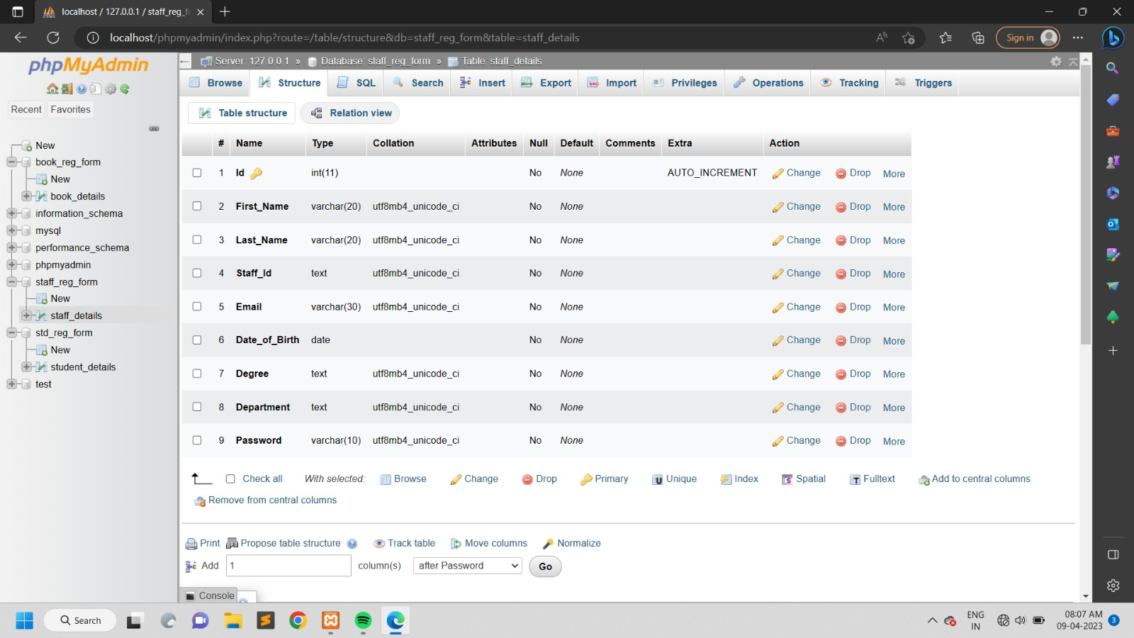
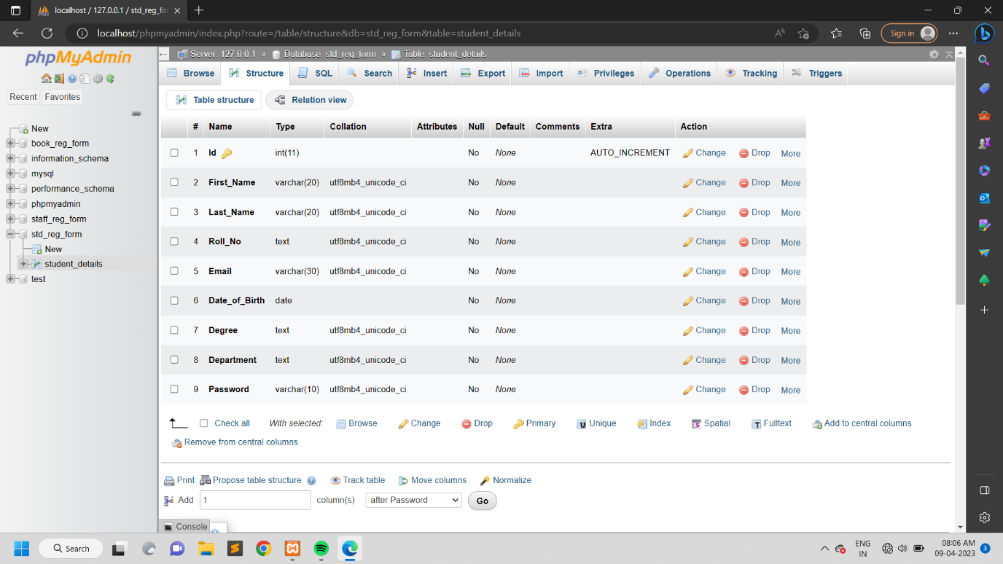
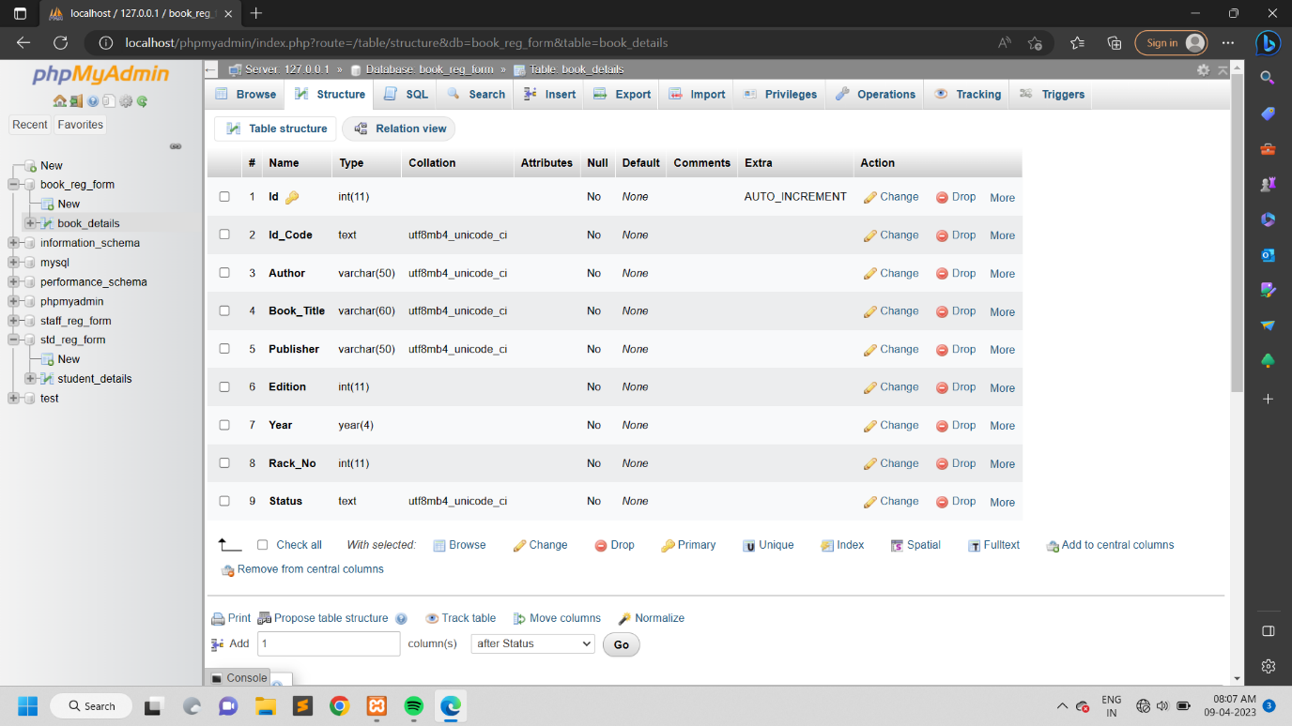
TABLE DESIGN OF USER REGISTER FORM :
TABLE DESIGN OF BOOK REGISTER FORM :

Slide 13
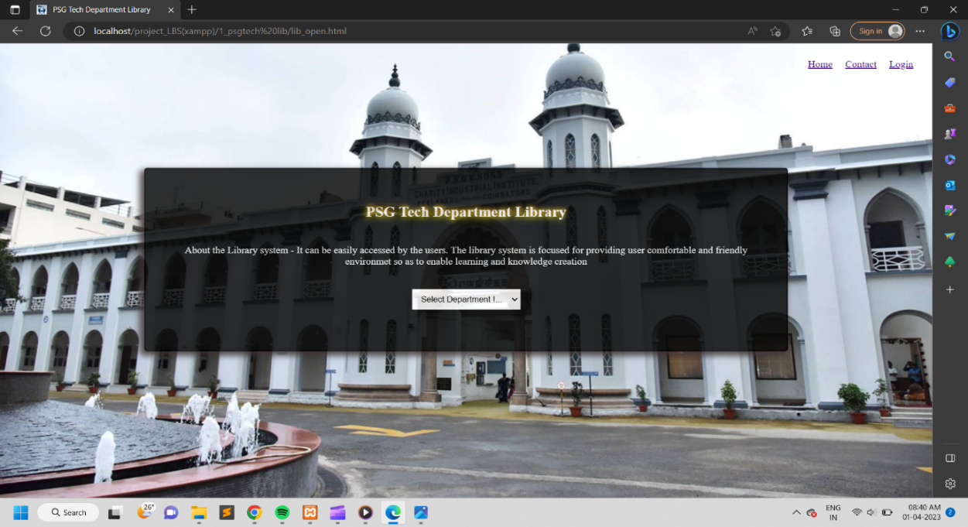
SYSTEM IMPLEMENTATION OF HOME PAGE :

Slide 14
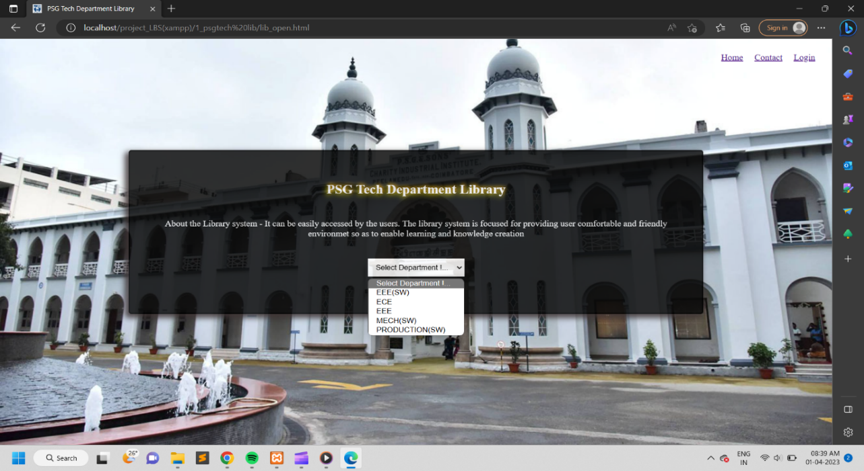
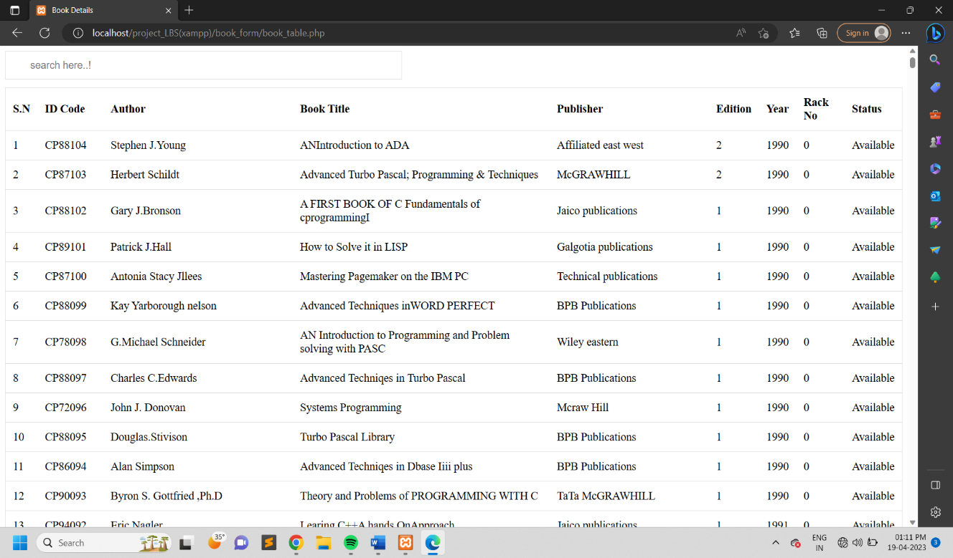
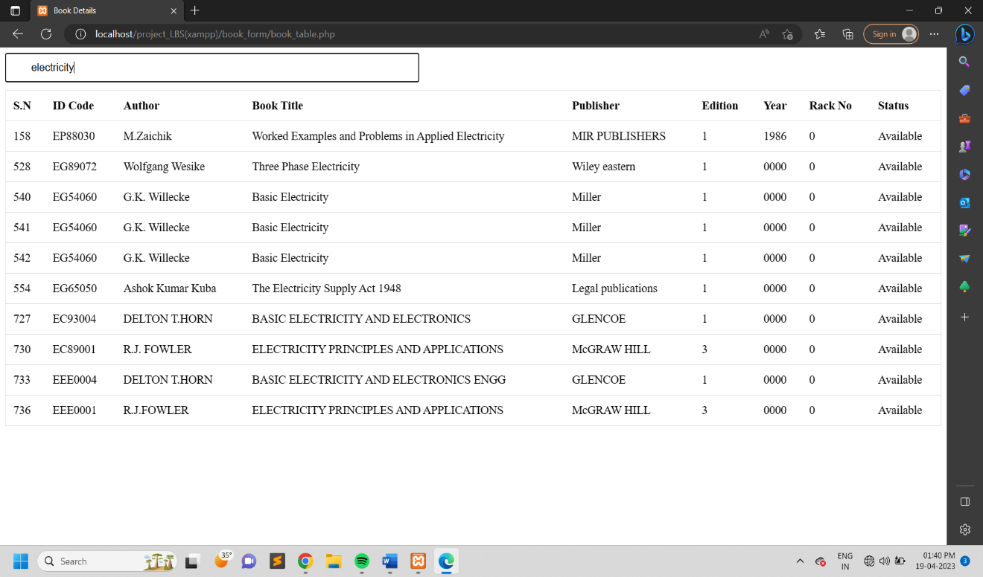
SELECT DEPARTMENT AND VIEW BOOK DETAILS :
SEARCH BOOK DETAILS :

Slide 15
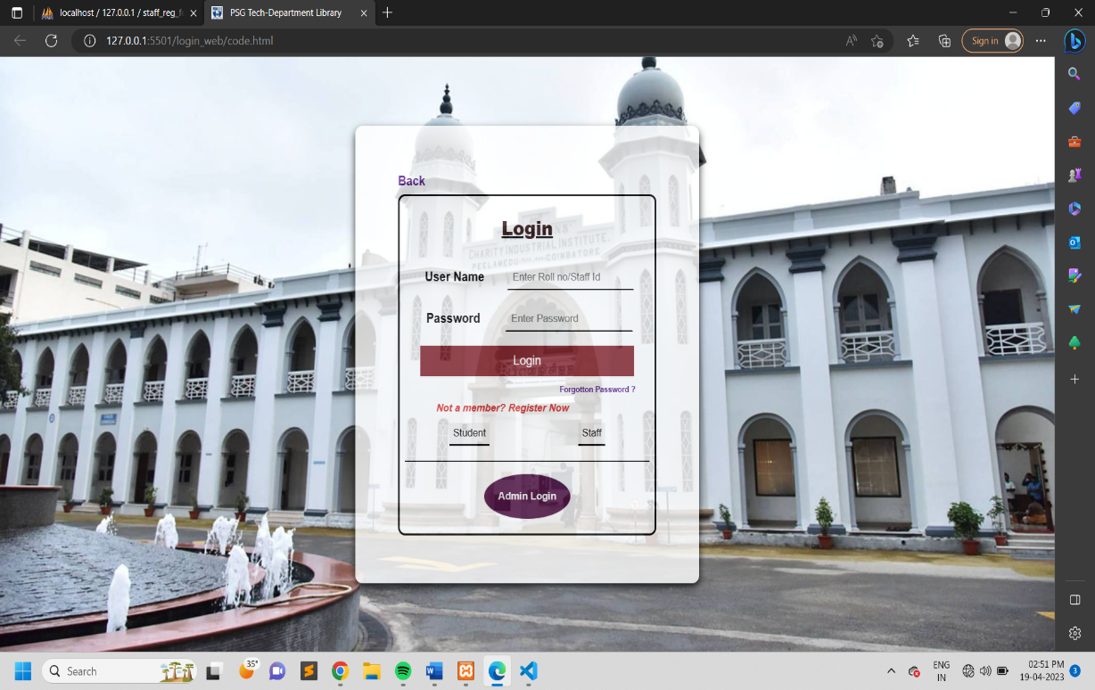
SYSTEM IMPLEMENTATION OF USER LOGIN :

Slide 16
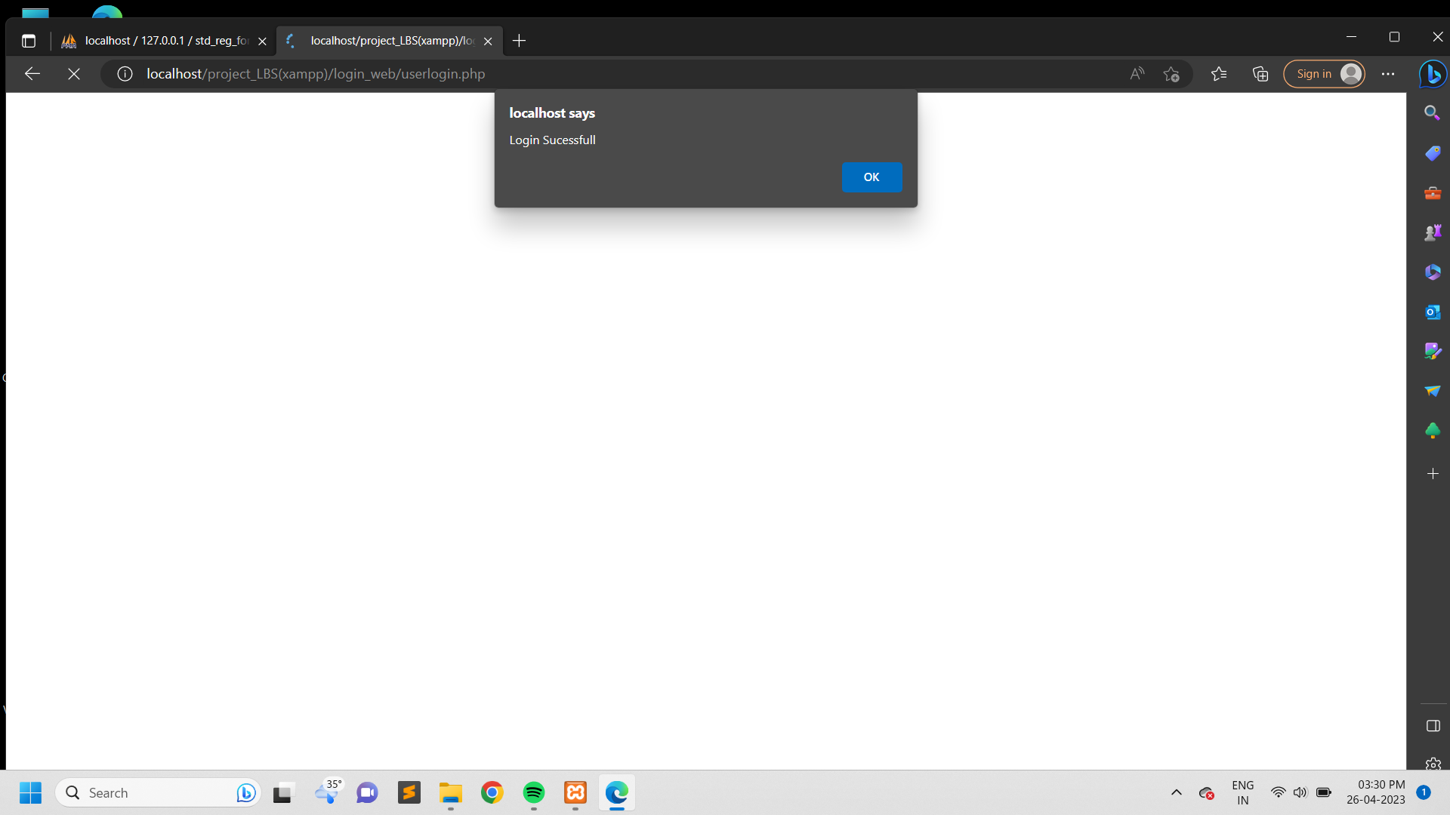
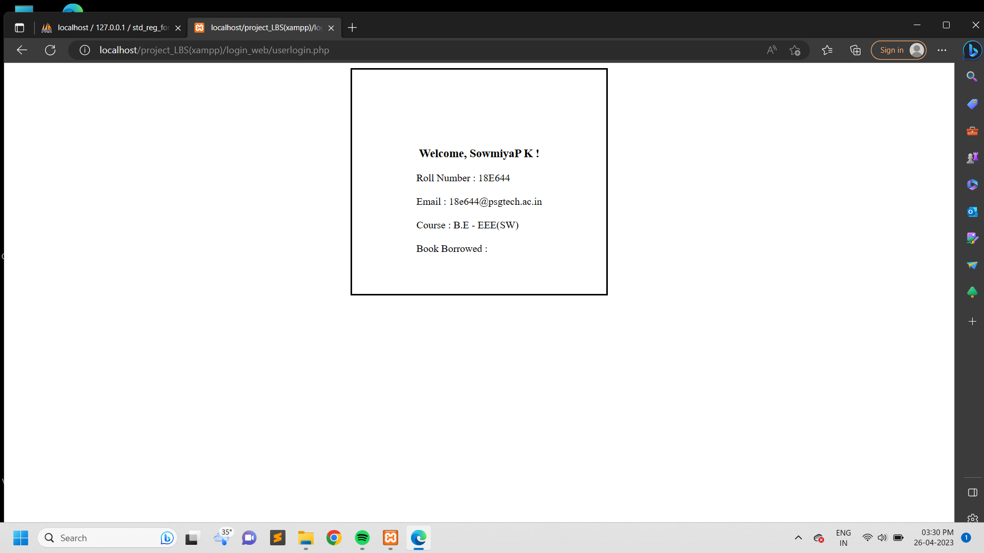
USER DASHBOARD :
LOGIN SUCCESSFULL
USER DETAILS AFTER LOGIN

Slide 17
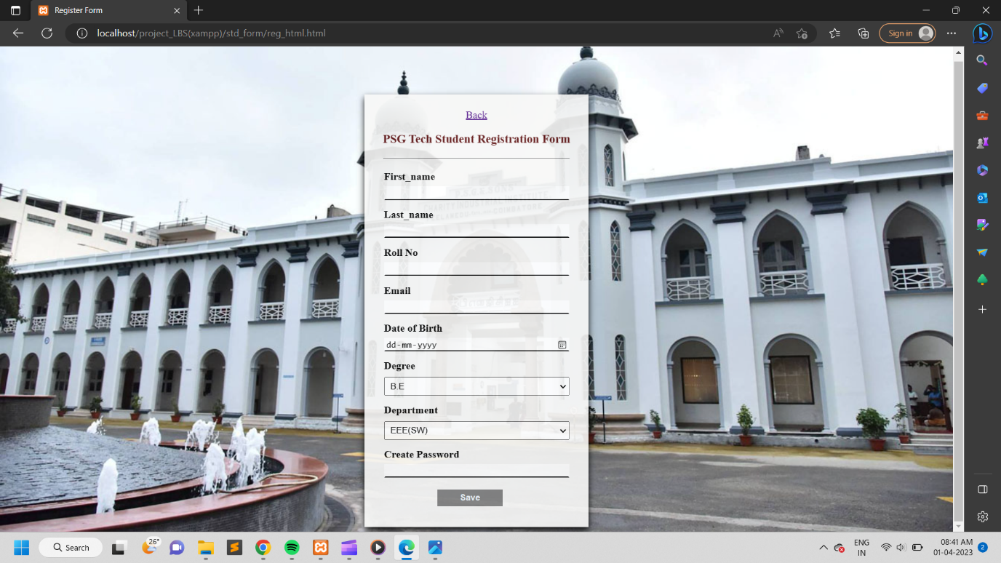

NEW USER REGISTER FORM :
STUDENT REGISTER FORM
STAFF REGISTER FORM

Slide 18
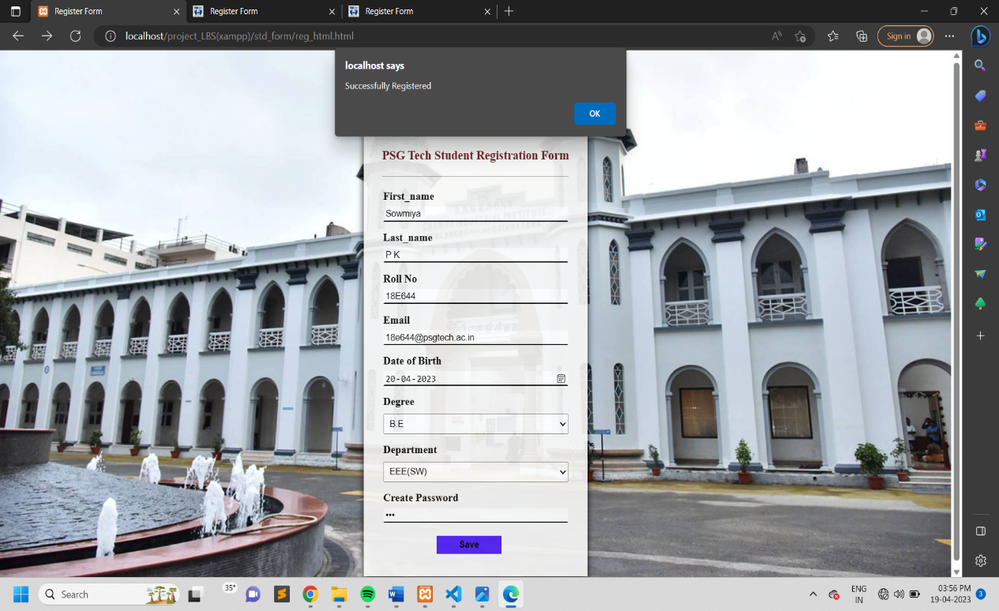
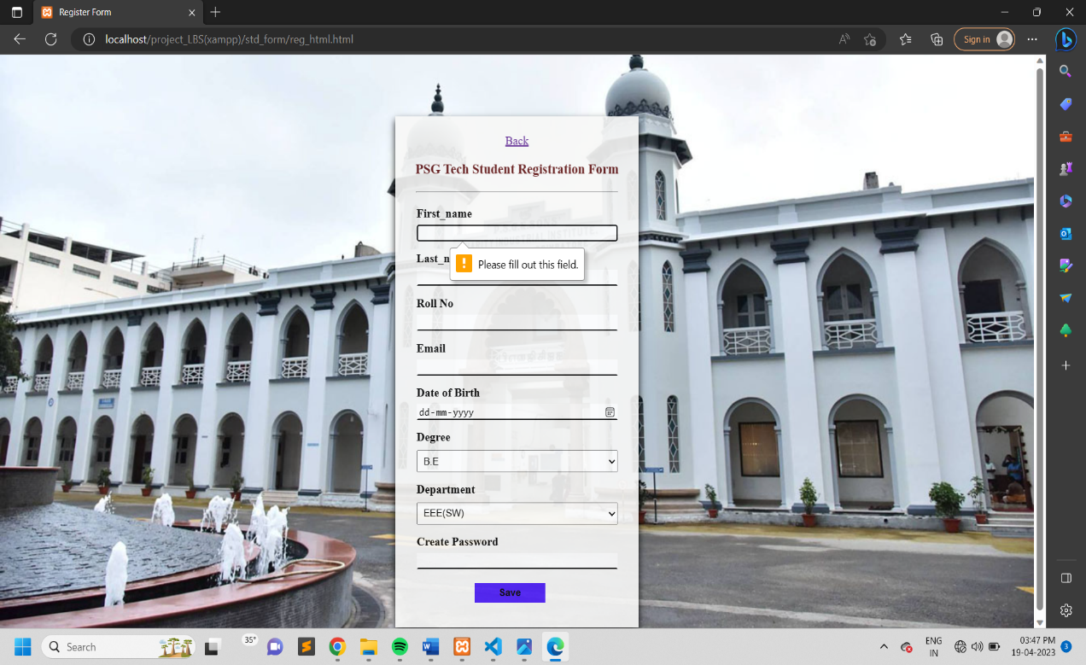
USER REGISTER FORM ALERT :
REQUIRED DETAILS REGISTERED SUCESSFULL
REQUIRED FIELD IS EMPTY

Slide 19
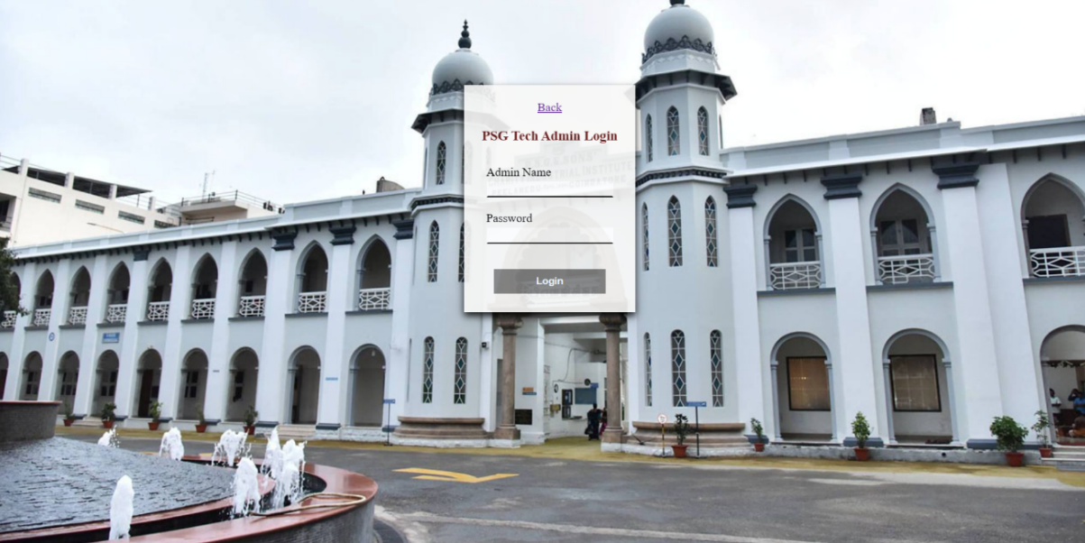
SYSTEM IMPLEMENTATION OF ADMIN LOGIN :

Slide 20
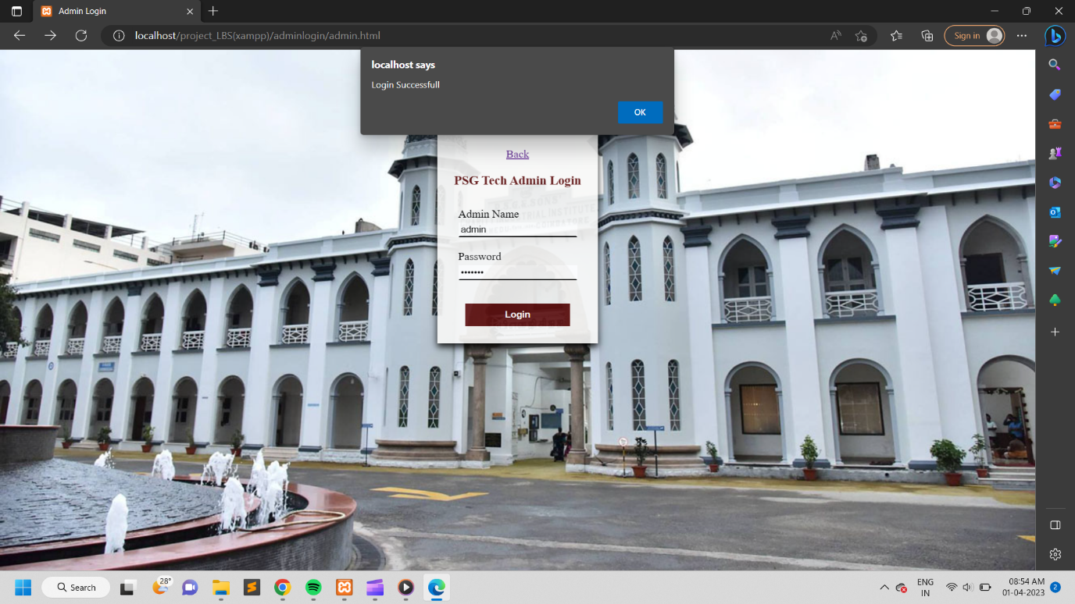
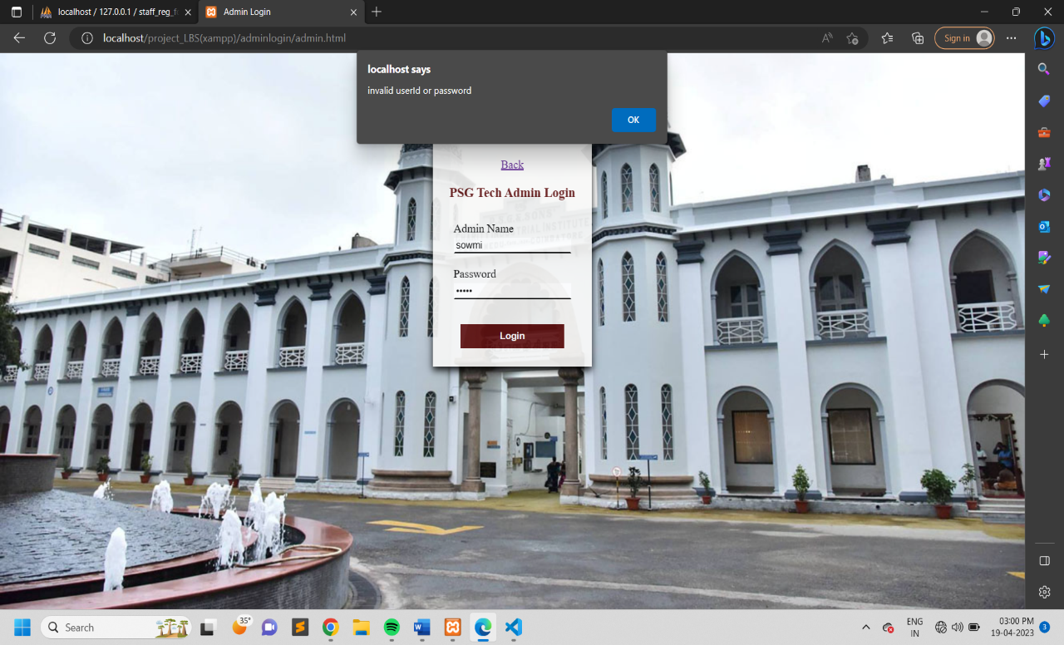
ADMIN LOGIN ACCESS :
LOGIN SUCCESSFULL
INVALID USERNAME OR PASSWORD

Slide 21
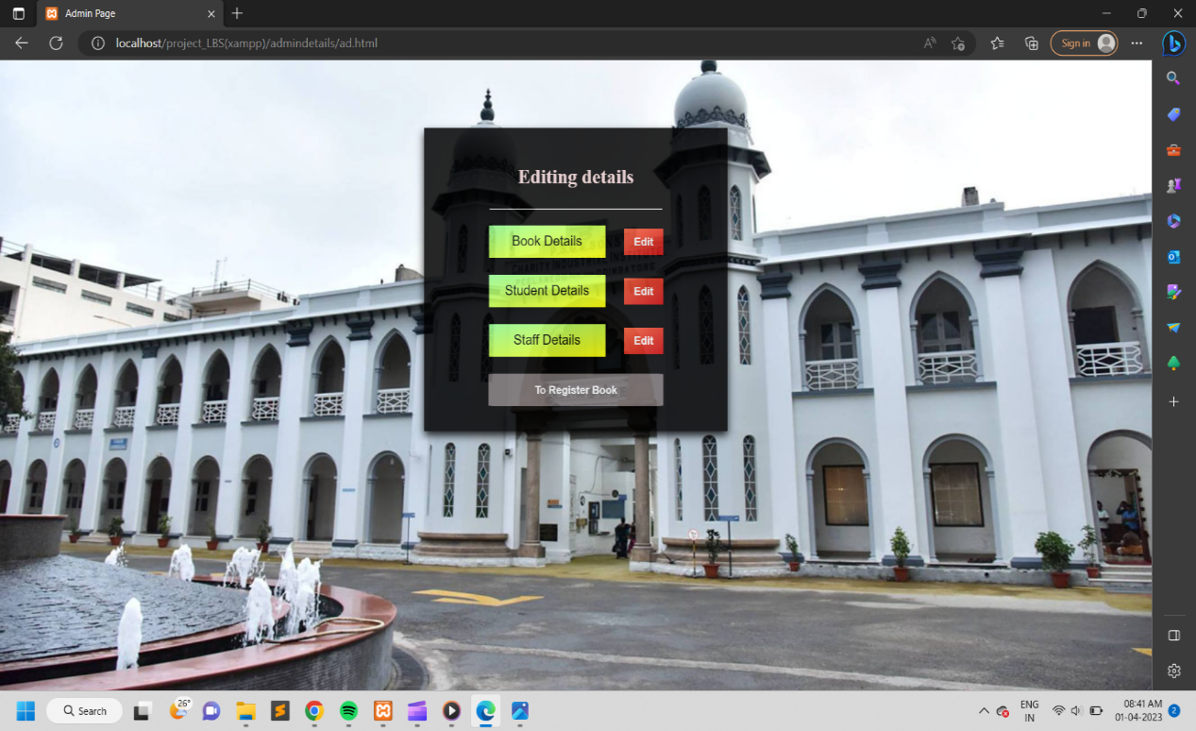
ADMIN DASHBOARD PAGE :
Only admin have access to register new books, view/update book details and user details

Slide 22
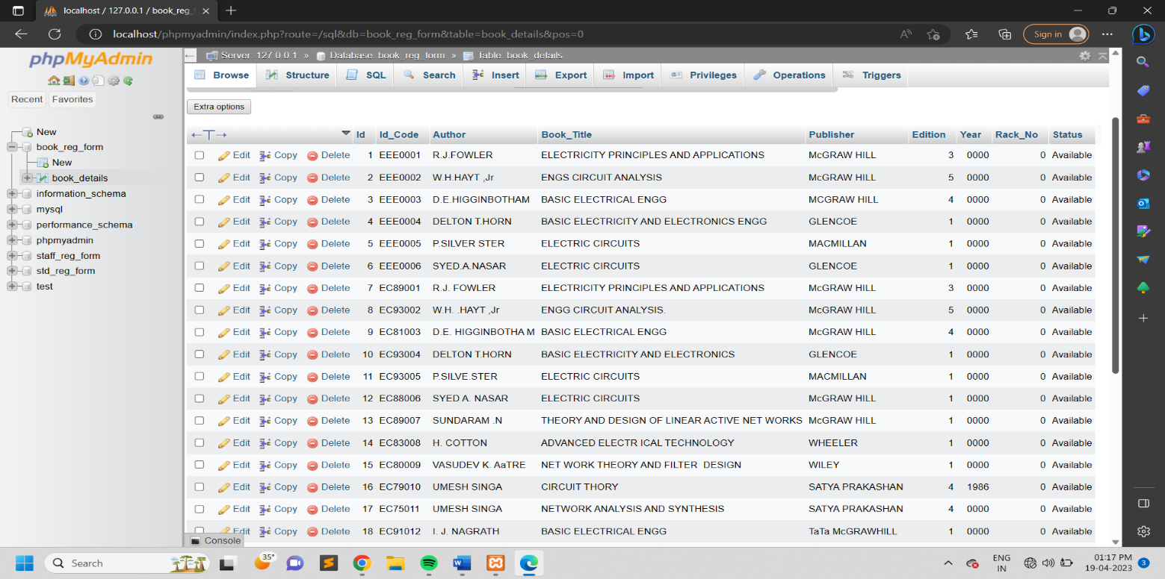
BOOK DETAILS AND EDIT :
BOOK DETAILS
BOOK DETAILS EDIT

Slide 23
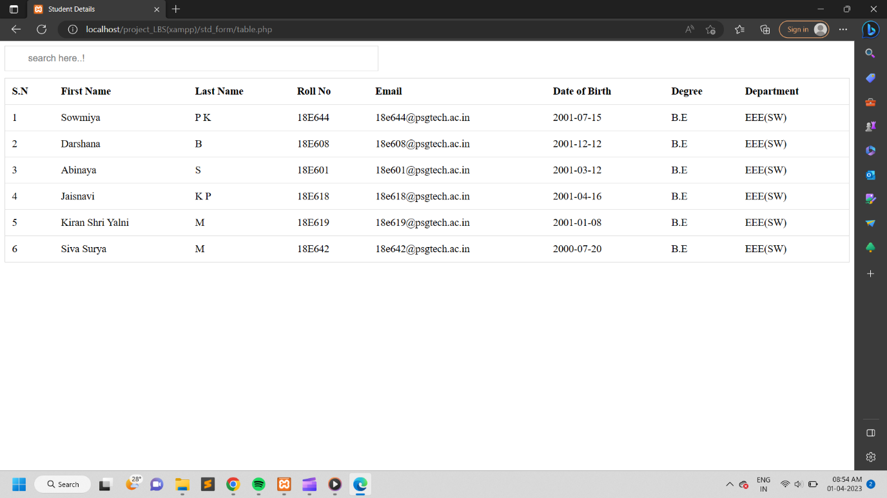
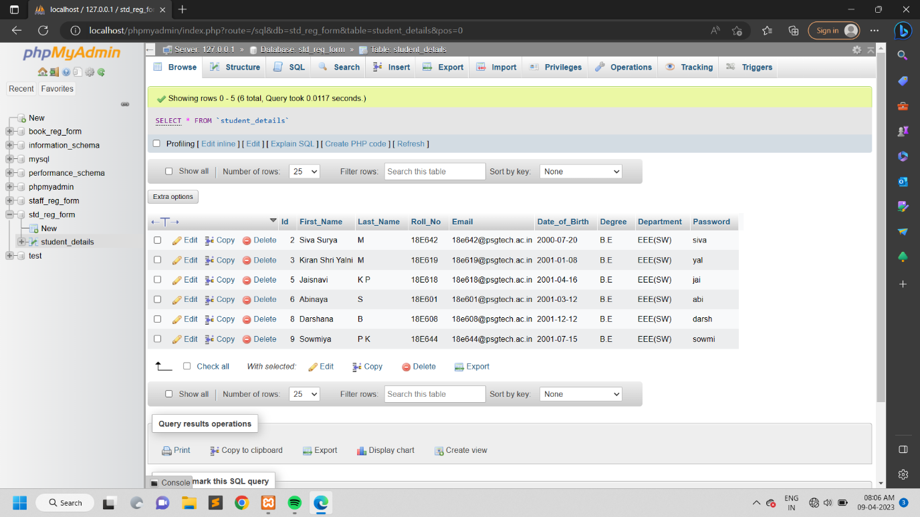
STUDENT DETAILS AND EDIT :
STUDENT DETAILS
STUDENT DETAILS EDIT

Slide 24
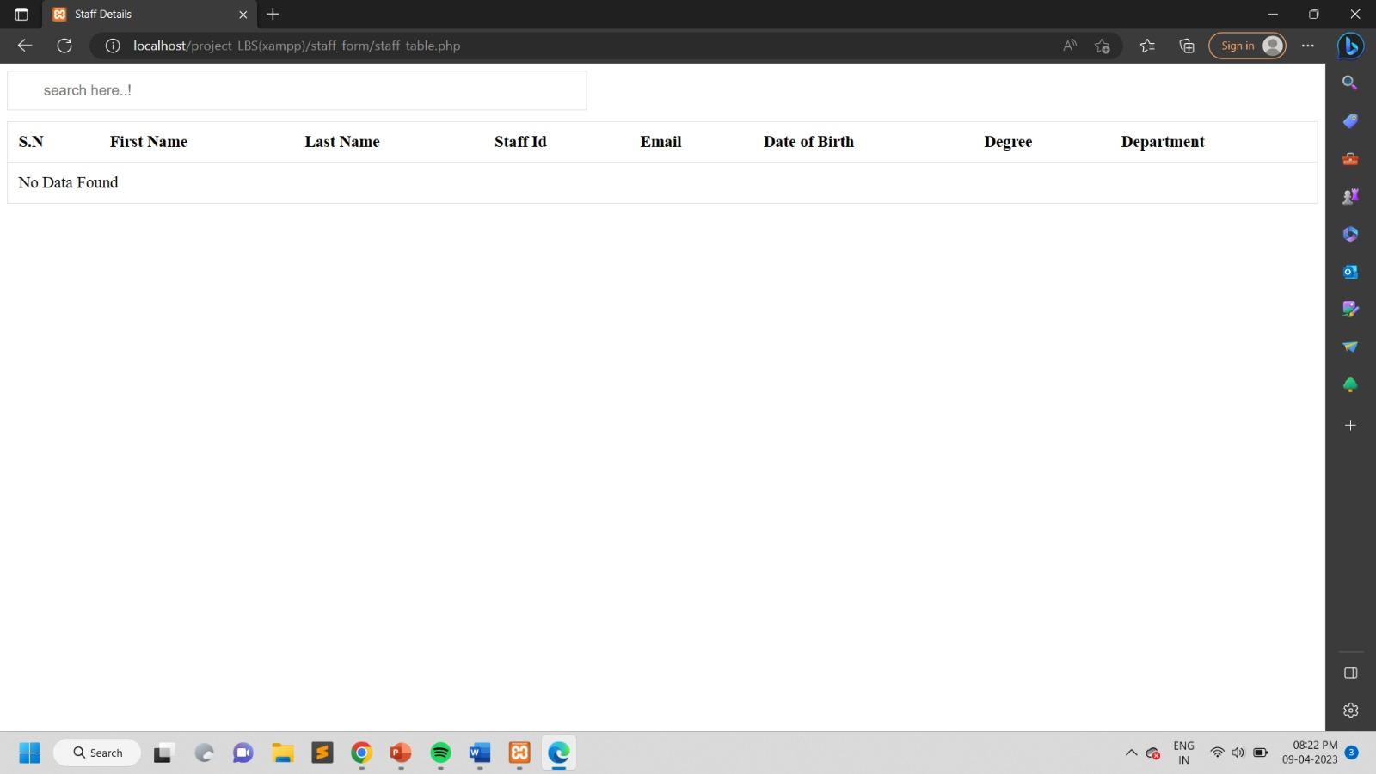
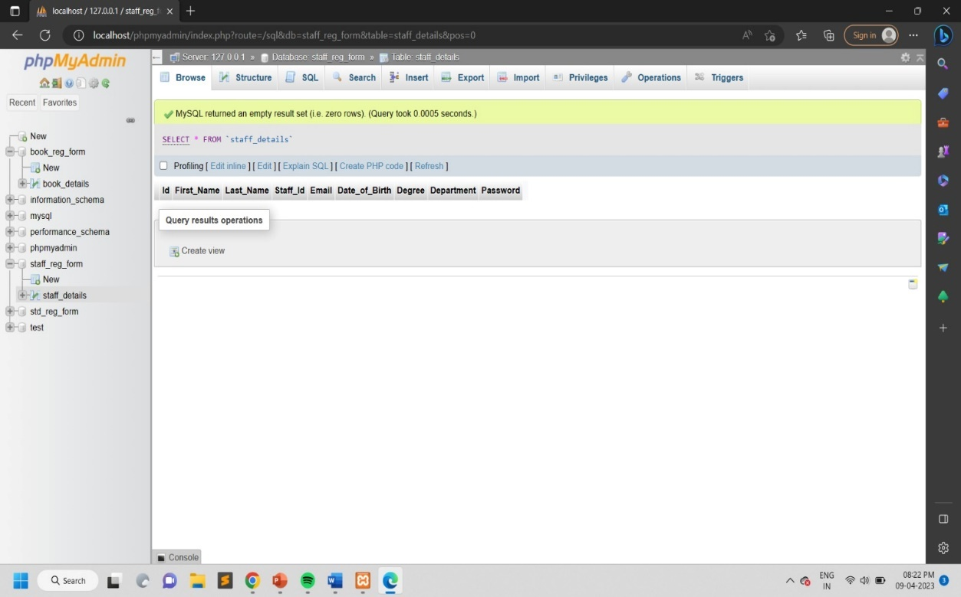
STAFF DETAILS AND EDIT :
STAFF DETAILS
STAFF DETAILS EDIT

Slide 25
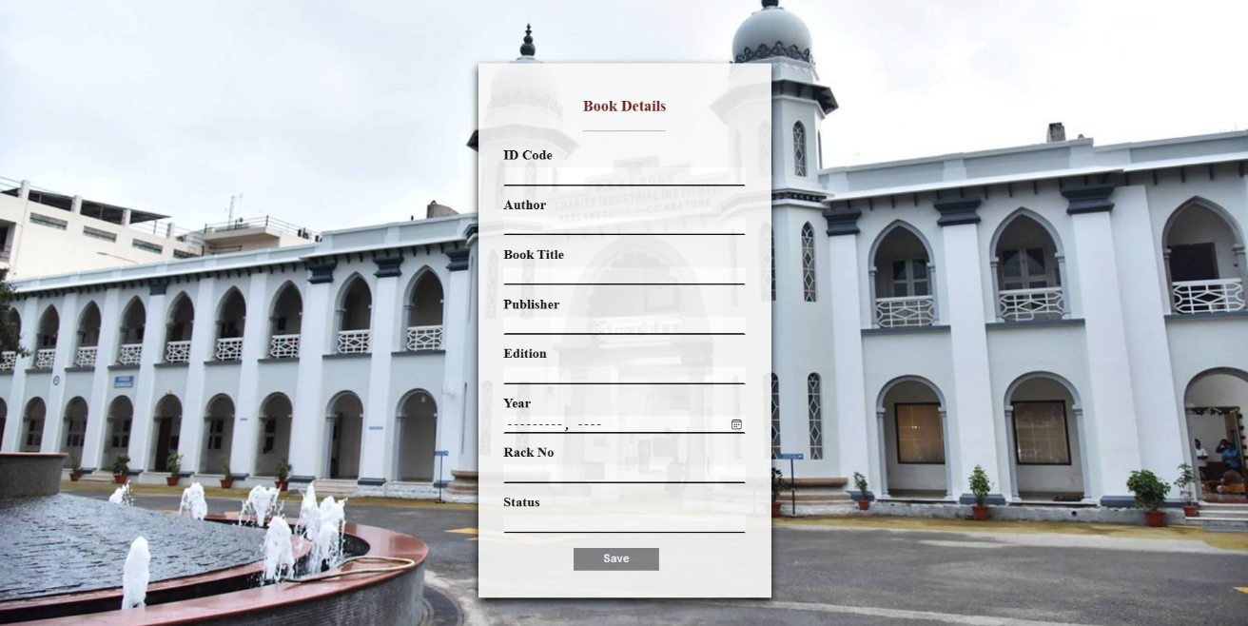
NEW BOOK REGISTER FORM :
Only admin have access to register new books

